Slide 1
Welcome!
Please, have a seat.
CWRU Quants
quants@case.edu
Notes:
Sources: https://github.com/CppCon/CppCon2017/blob/master/Presentations/When%20a%20Microsecond%20Is%20an%20Eternity/When%20a%20Microsecond%20Is%20an%20Eternity%20-%20Carl%20Cook%20-%20CppCon%202017.pdf https://blog.cloudflare.com/branch-predictor/

Slide 2
Agenda
High-Frequency Trading
Computer Software
Computer Hardware
Miscellaneous
Coming in Part 2
Notes:
Christo

Slide 3
But first…

Slide 4

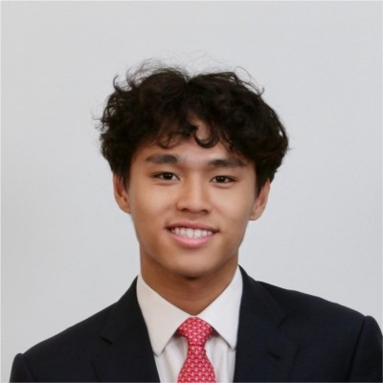

Tom to Morgan Stanley!

Slide 5

Attendance | CampusGroups
Notes:
Christo

Slide 6

Discord (important!)
Notes:
Christo

Slide 7
High-Frequency Trading
“The elements of good trading are: (1) cutting losses,
(2) cutting losses, and
(3) cutting losses.
If you can follow these three rules, you may have a chance.”
Ed Seykota
Notes:
Christo

Slide 8
A High-Level Overview
HFT is usually done by market makers
Market makers don’t build positions to make directional bets, they provide liquidity and prices to the market
Goal of HFT strategies is to make small, profitable trades very frequently
Avoiding large losing trades is paramount! Avoiding bad trades is more important than making good trades
Speed is the name of the game. Being nanoseconds faster than the competition is a win
How can we do this?
Optimize EVERYTHING (hardware, network, operating system, software)
Notes:
Christo

Slide 9
HFT is Hard
Critical code only runs about 0.01% of the time, despite being 1-5% of the codebase
“Critical code” entails reading packets from the exchange, decoding them, deciding if the state of the market they convey represents an interesting change, runs risk checks, deciding if it makes sense to trade, and executing (or modifying) the trade.
Computer hardware, operating systems, and networks want to set up fair environments for all users/processes to maximize throughput – this is at odds with a process/system that wants to hog time and resources only to sit on its hands most of the time
Consistency is key – if you’re the fastest 9 times out of 10 but get whacked by a network hiccup once, you can end up negative, despite being faster on average
Notes:
Christo

Slide 10
Computer Software
“C++ enables zero-overhead abstraction to get us away from the hardware without adding cost”
Bjarne Stroustrup
Notes:
Transition

Slide 11
Every Cycle Counts
We want to know and have control of the computer’s actions at each cycle
Assembly languages let us do this, but assembly code is architecture-specific and therefore not portable
C++ allows developers to exercise low (enough) level control, only sacrificing necessary components to ensure portability and ergonomic development
For example, assembly language allows you to directly access carry and overflow flags after an arithmetic operation, but some CPUs don’t have these flags (MIPS, RISC-V, etc). So C/C++ doesn’t allow it
There is still a cost to this abstraction. The compiler, machine architecture, libraries, build and link options, etc. can all obfuscate what’s going on under the hood
Cue godbolt.org (made by Matt Godbolt. Ex Google/DRW/Coinbase/Aquatic btw)
Notes:
Christo

Slide 12
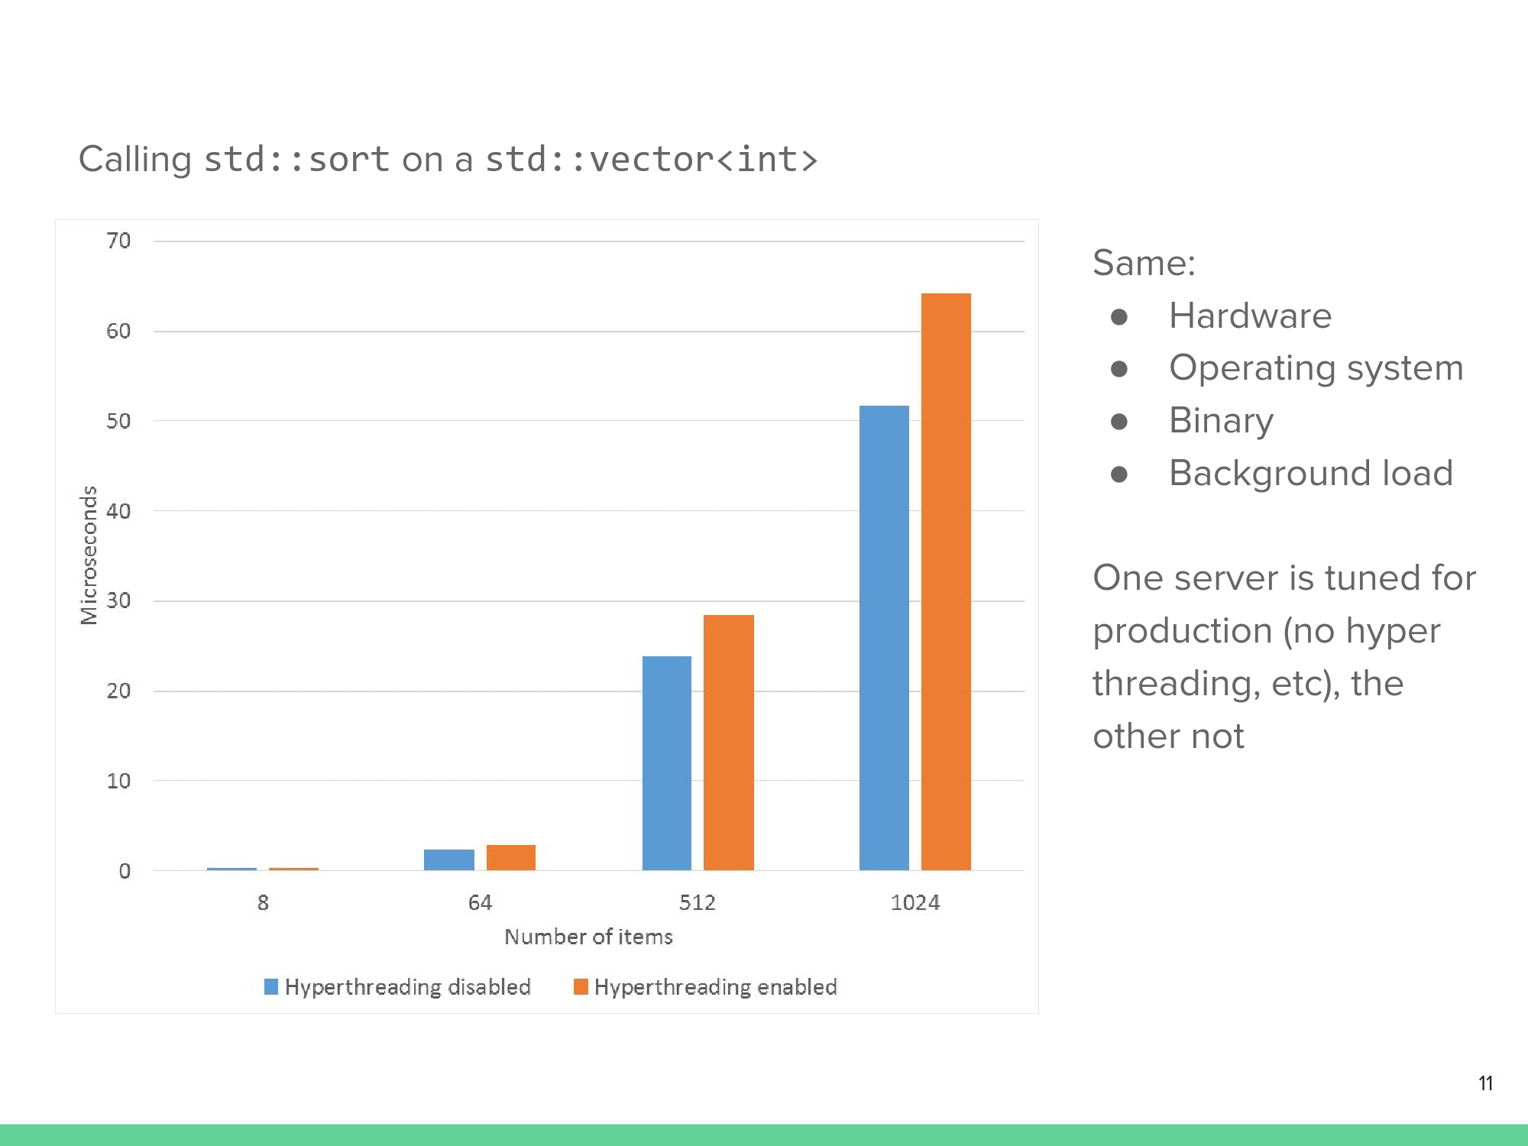
Insights from Assembly and the Compiler
Generally, calls and jumps are more expensive
Less machine code is generally better
Conditional moves tend to be less expensive than jumps
Optimizing your BIOS, Linux kernel, threading configurations, etc. all matter!
Hyperthreading slows us down
in this instance because
threads on the same core share
a cache. So if 2 threads are
sharing a core, they each get
half the cache or a race cond-
ition situation emerges.
Notes:
Christo

Slide 13
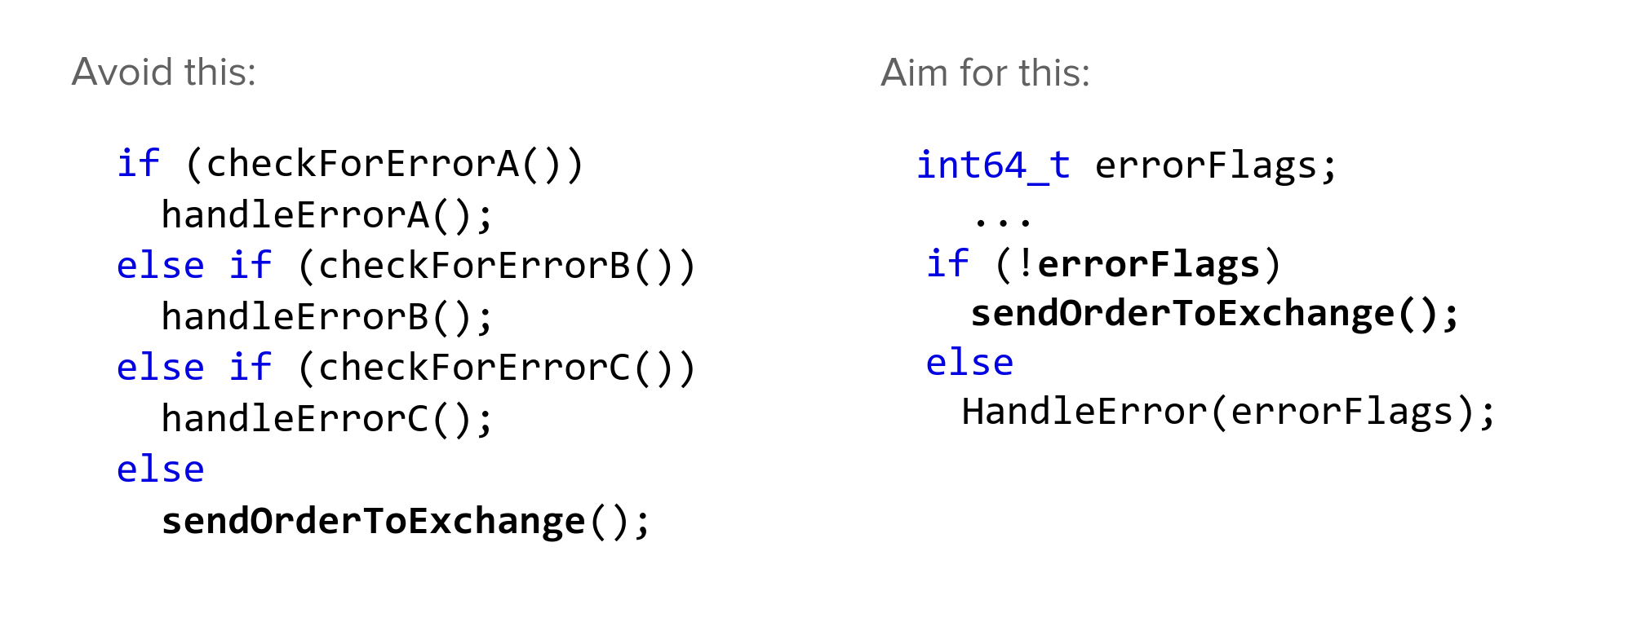
Coding Techniques
Branches in code are slow. Fewer of them means the compiler can optimize hot code better.
That could look like:
1
2
1
3
2
4

Slide 14
Cache Friendliness
The code on the right compiling to less instructions also means that less pressure is put on the instruction cache
The instruction cache is a small, fast form of memory that stores frequently used instructions, allowing the CPU to retrieve them quickly
Additionally, we don’t know what all those error handling functions are doing to either the instruction or data caches, so removing them can only be neutral or positive
Our one if statement being a check if an integer is 0 or not is great, since modern architectures use all kinds of tricks to dramatically speed up that one use case
Notes:
Tom
https://www.davidhbailey.com/dhbpapers/overfit-tools-at.pdf

Slide 15
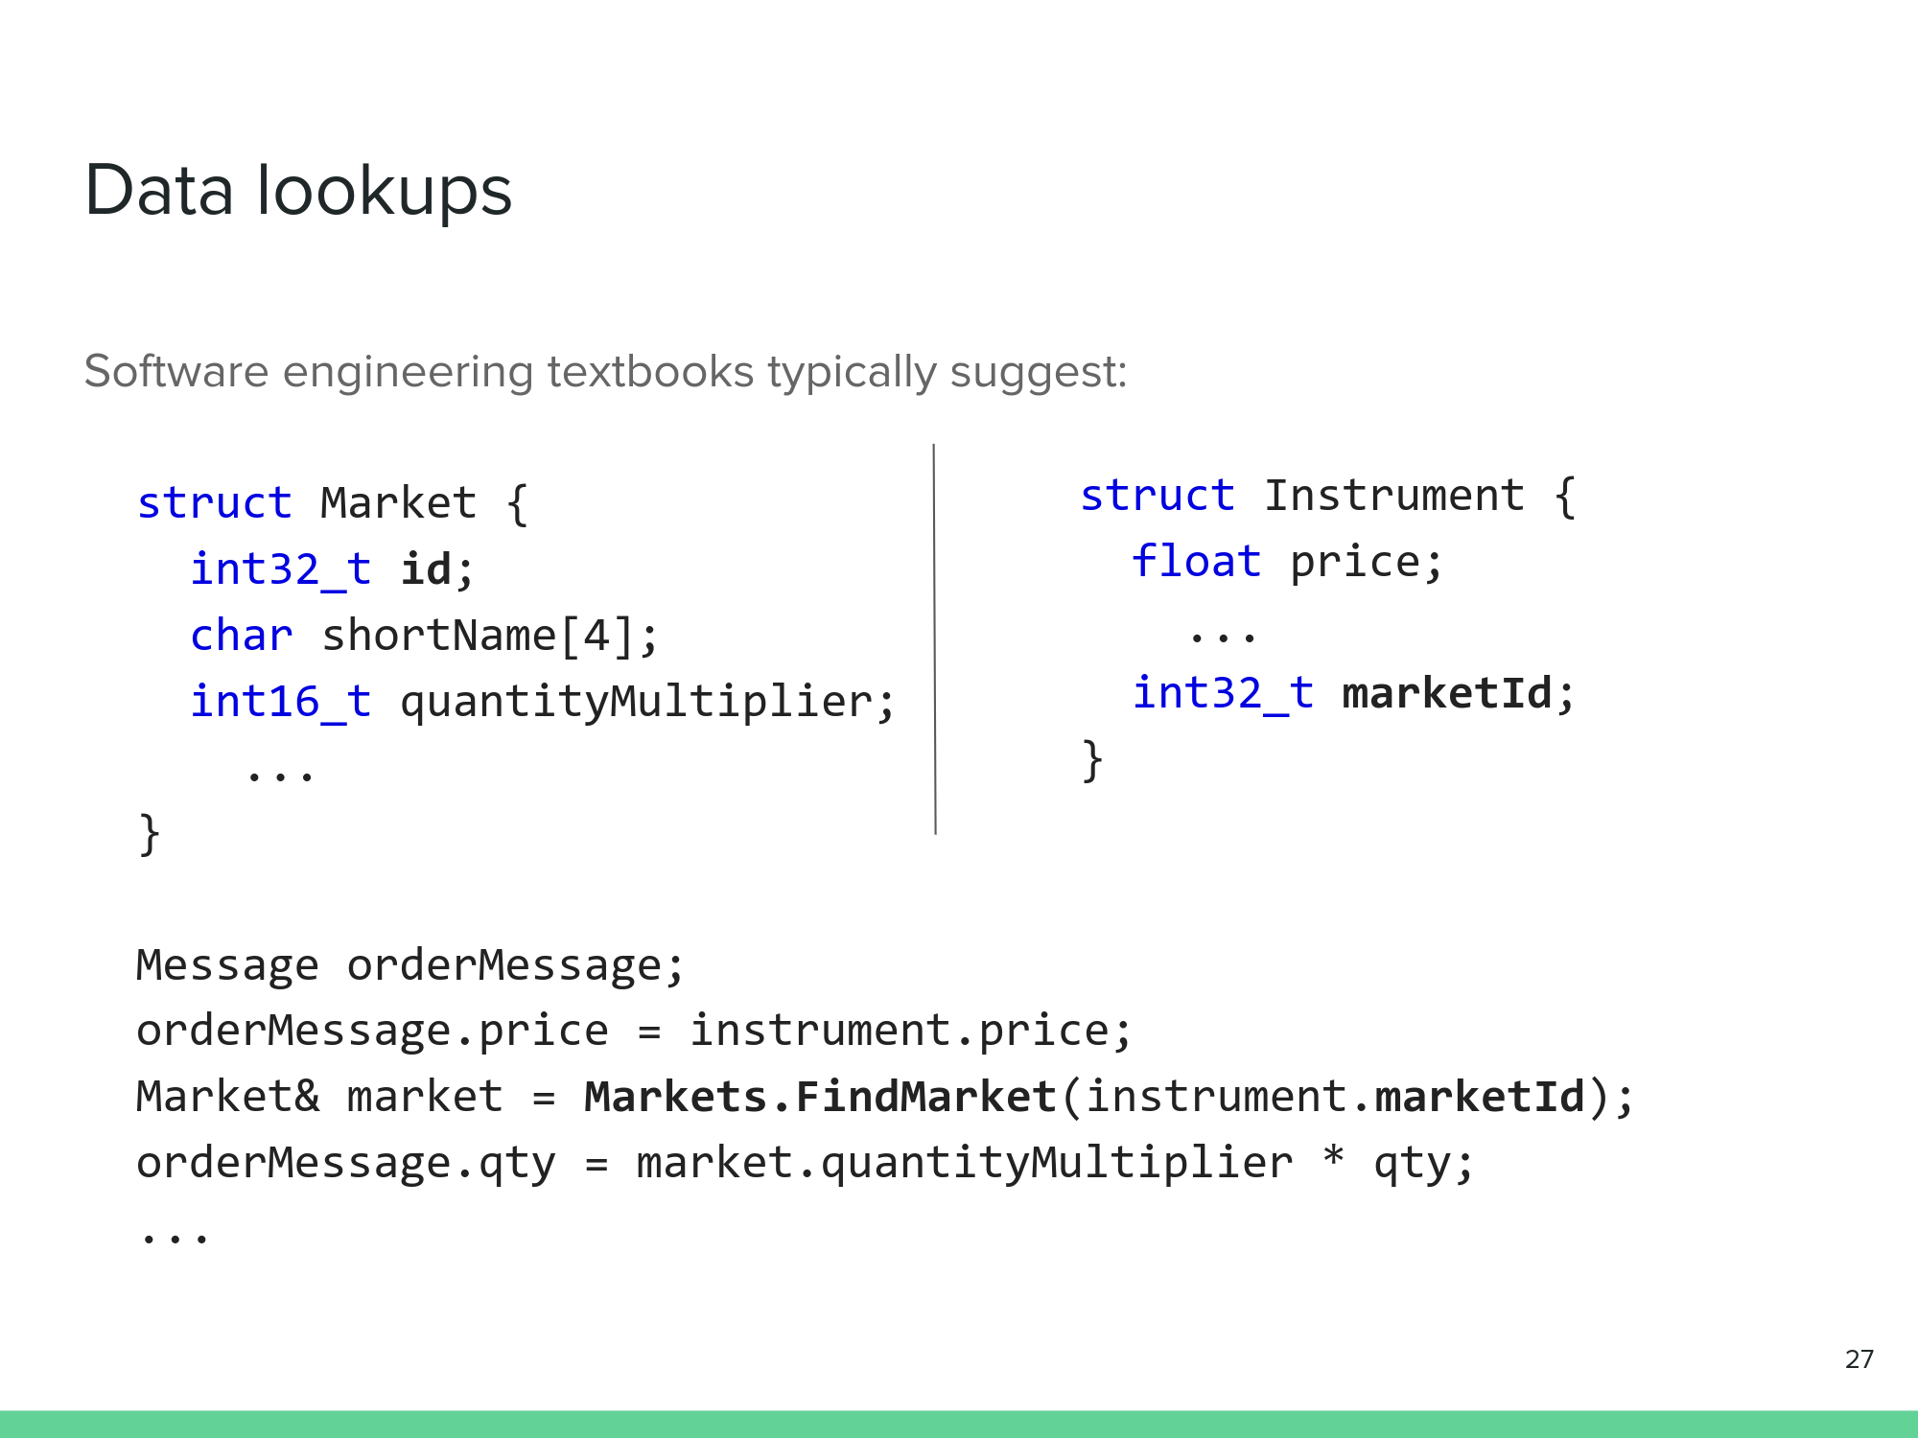
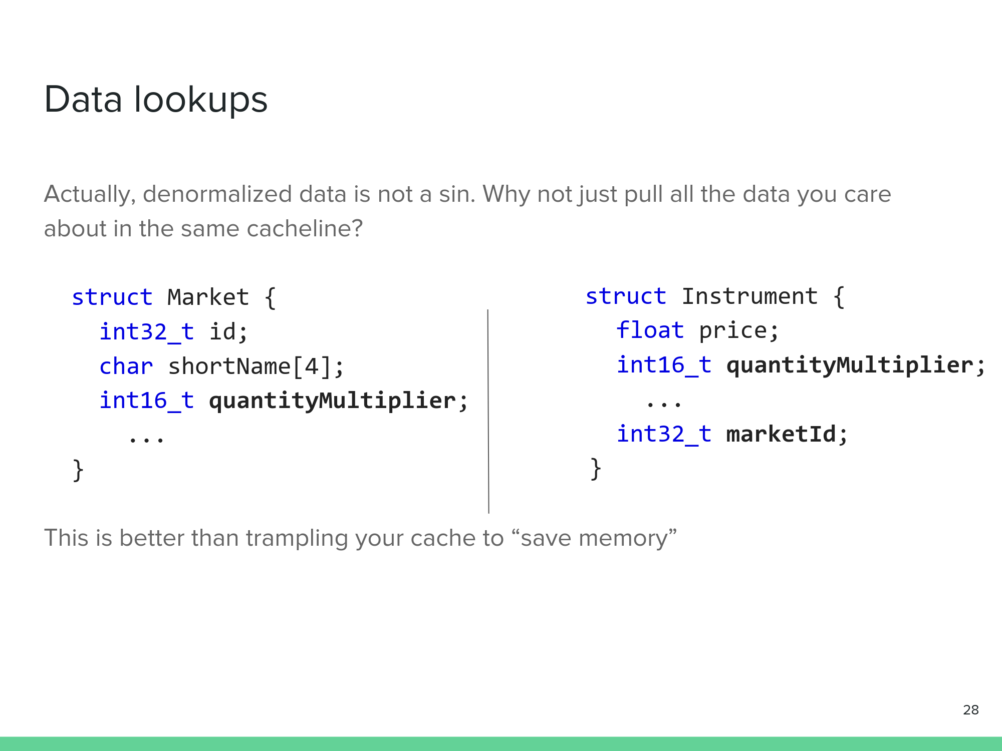
An example of data cache friendliness
Notes:
Tom
https://www.davidhbailey.com/dhbpapers/overfit-tools-at.pdf

Slide 16
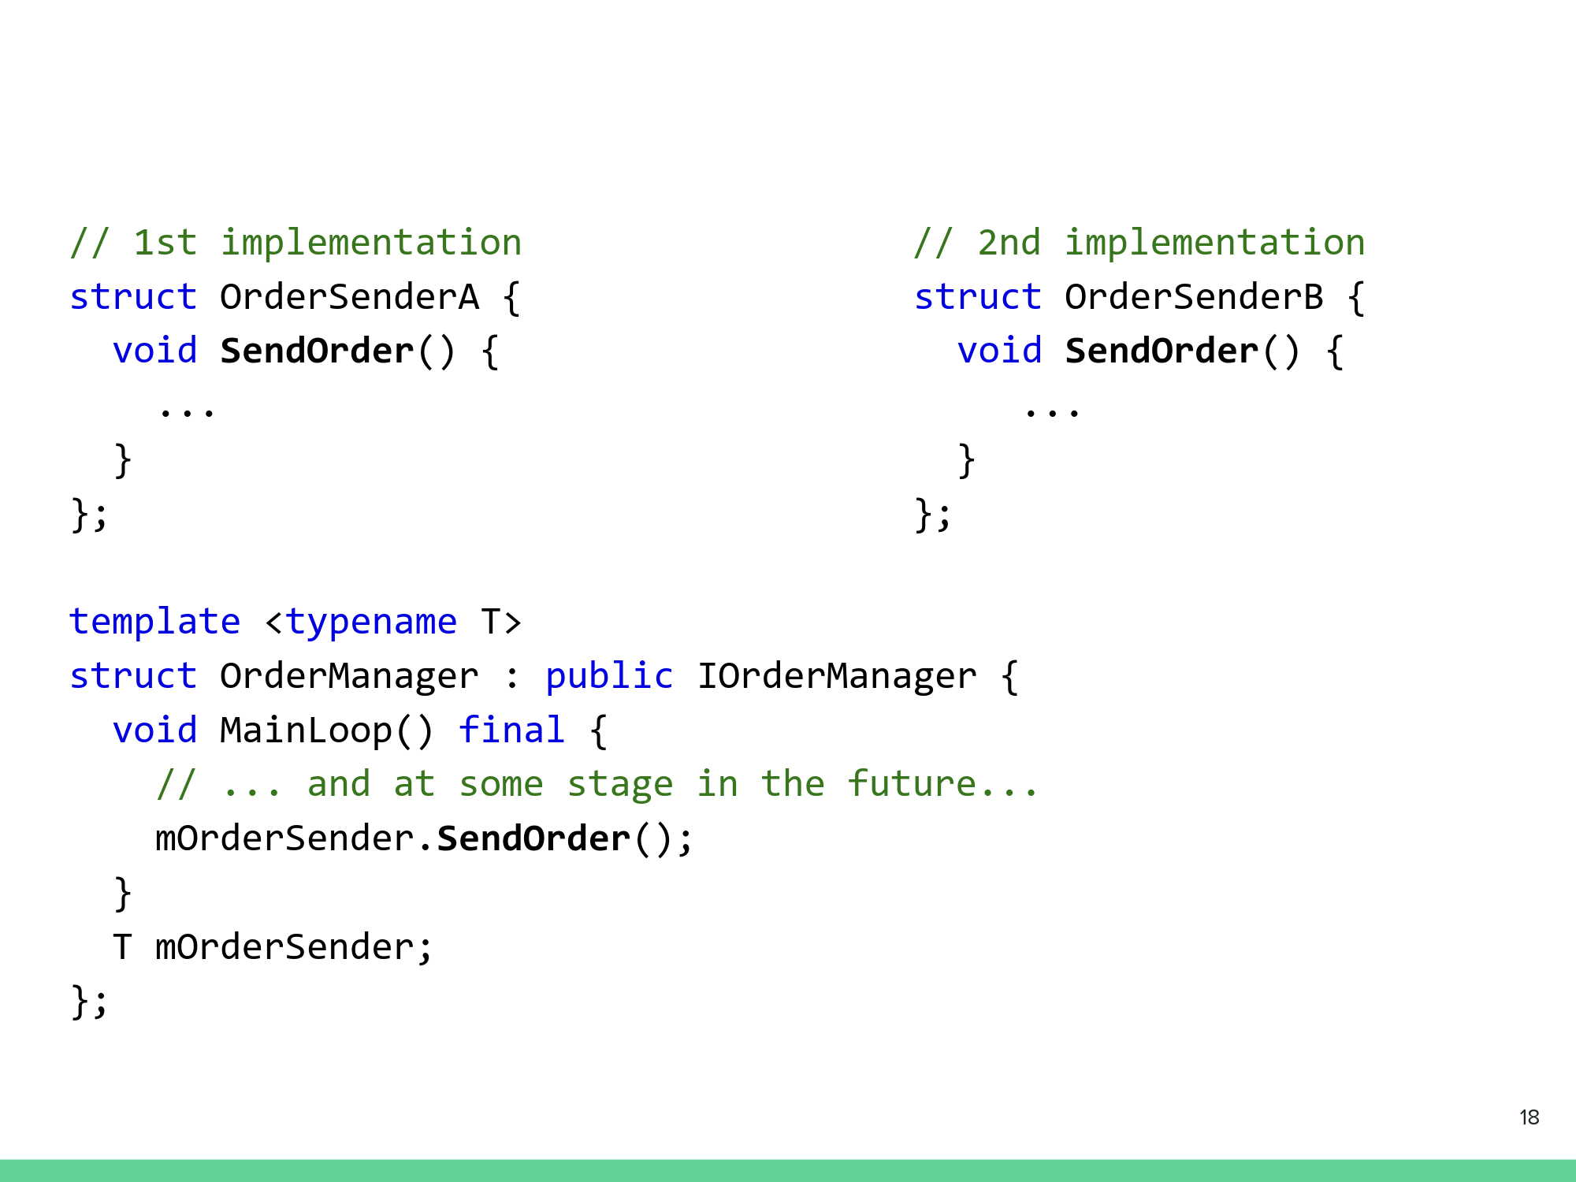
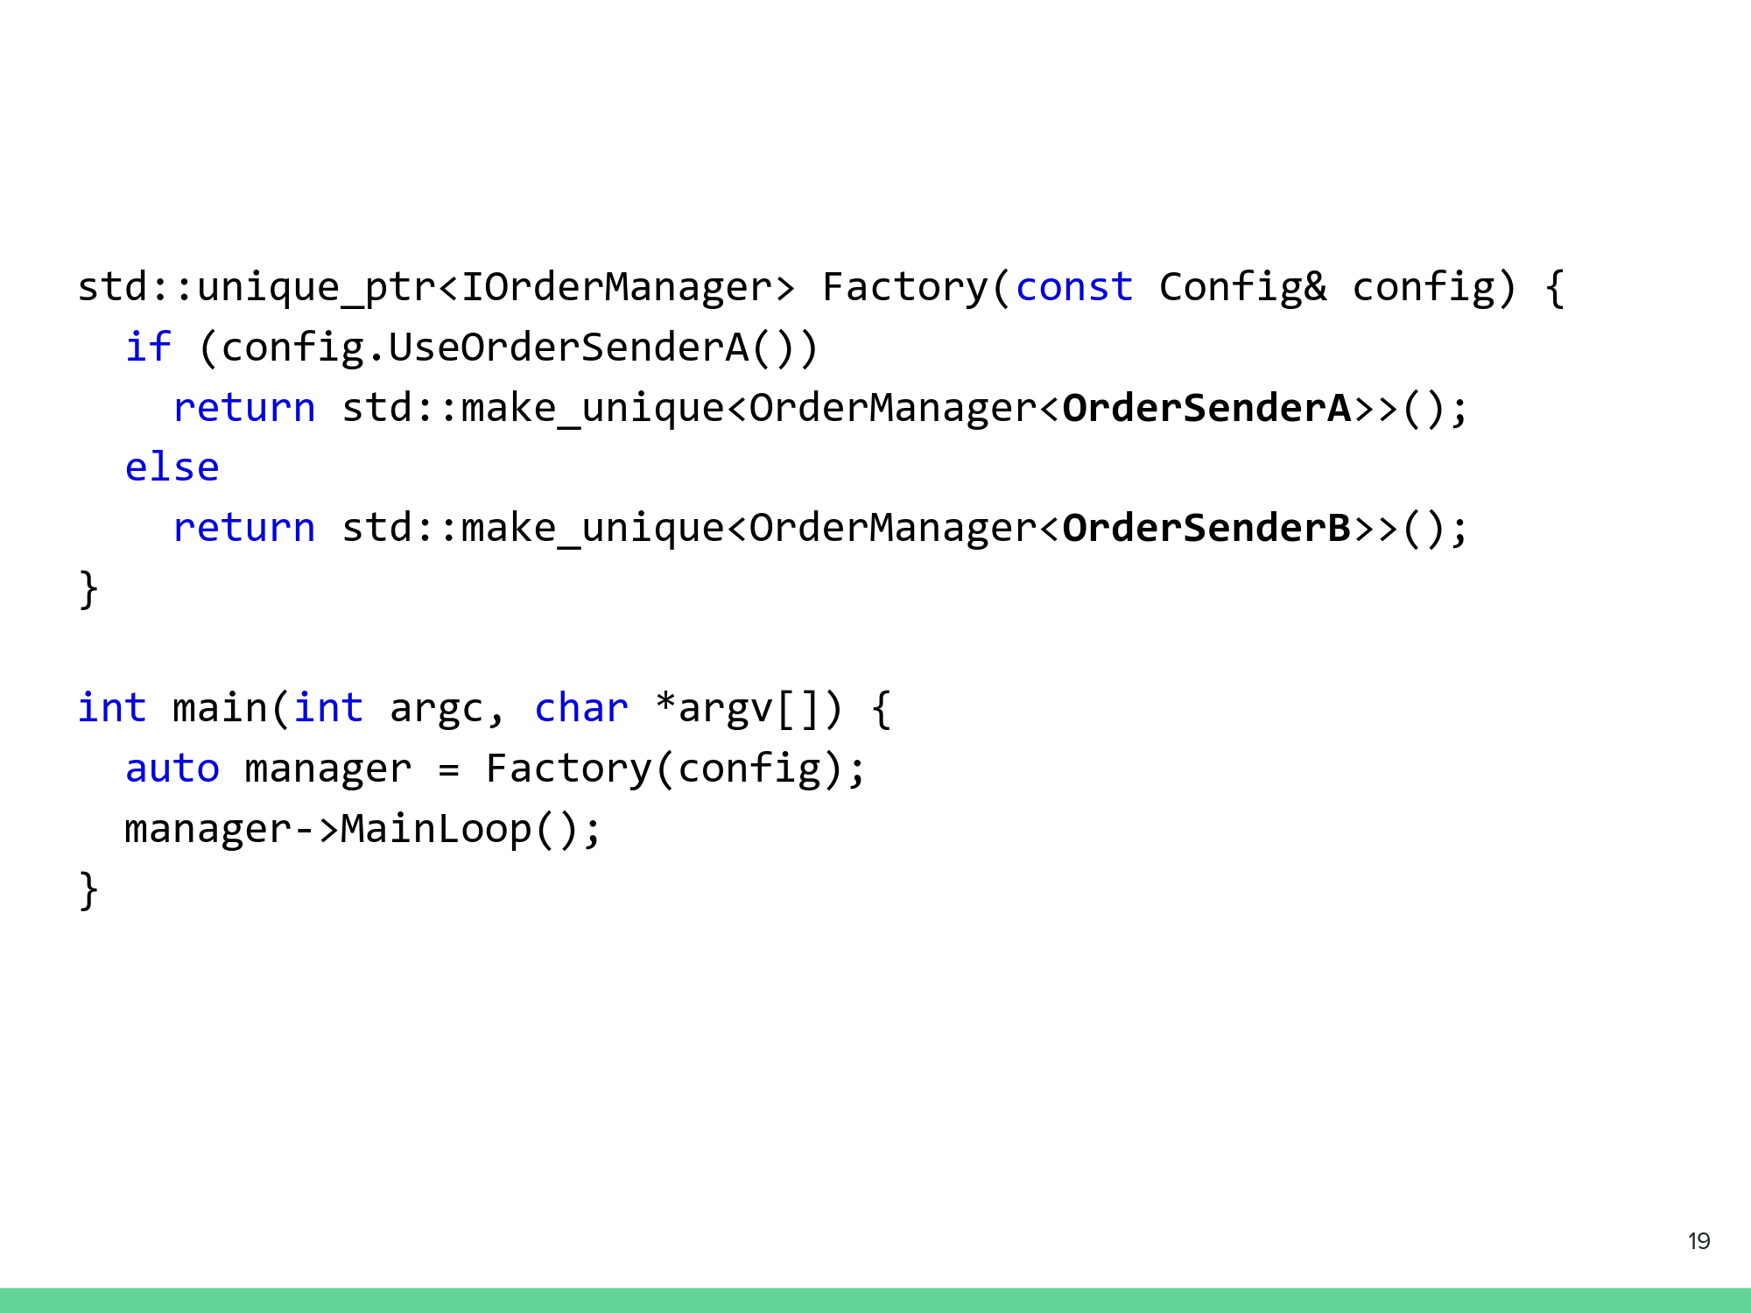
Templates
Virtual method calls are used when you don’t know what class to instantiate at compile time
They are slow (requires vtable lookup, vtables can get very large)
If we know the complete set of classes that could be instantiated, template metaprogramming can be used
Notes:
Ethan
https://carmamaths.org/resources/backtest/

Slide 17
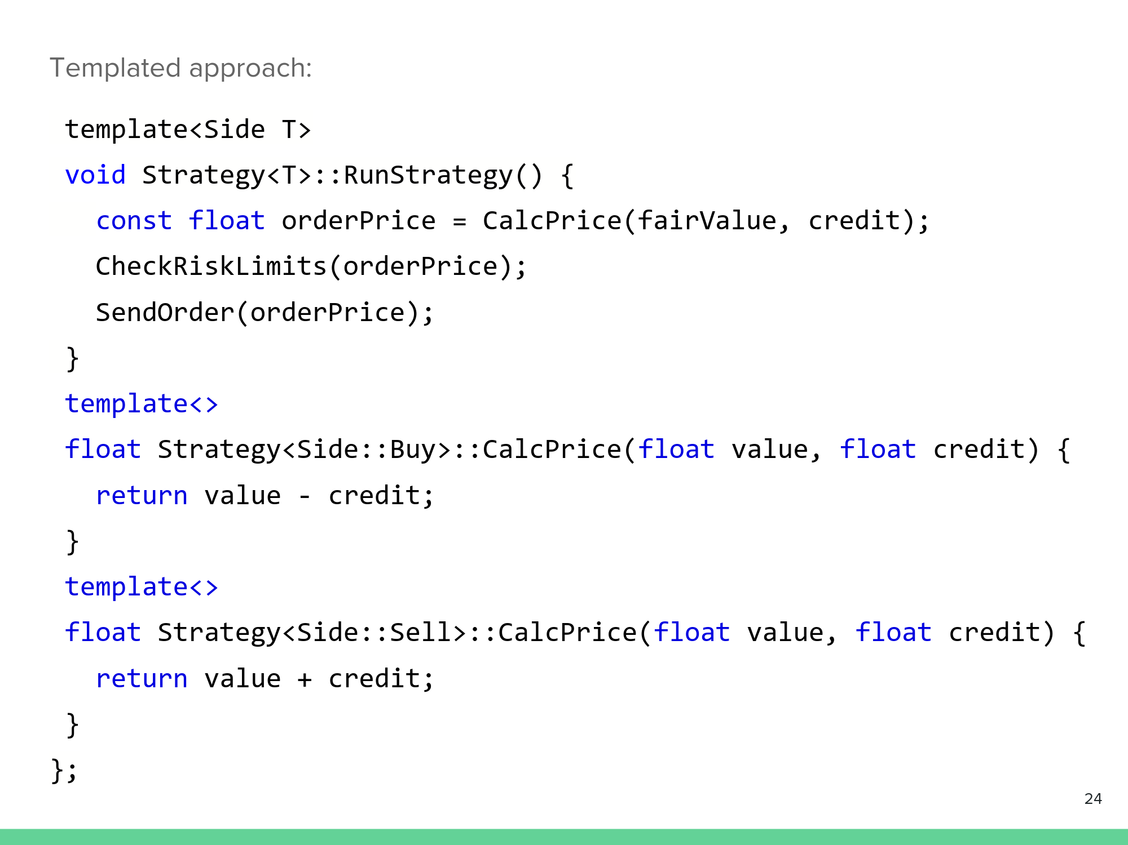
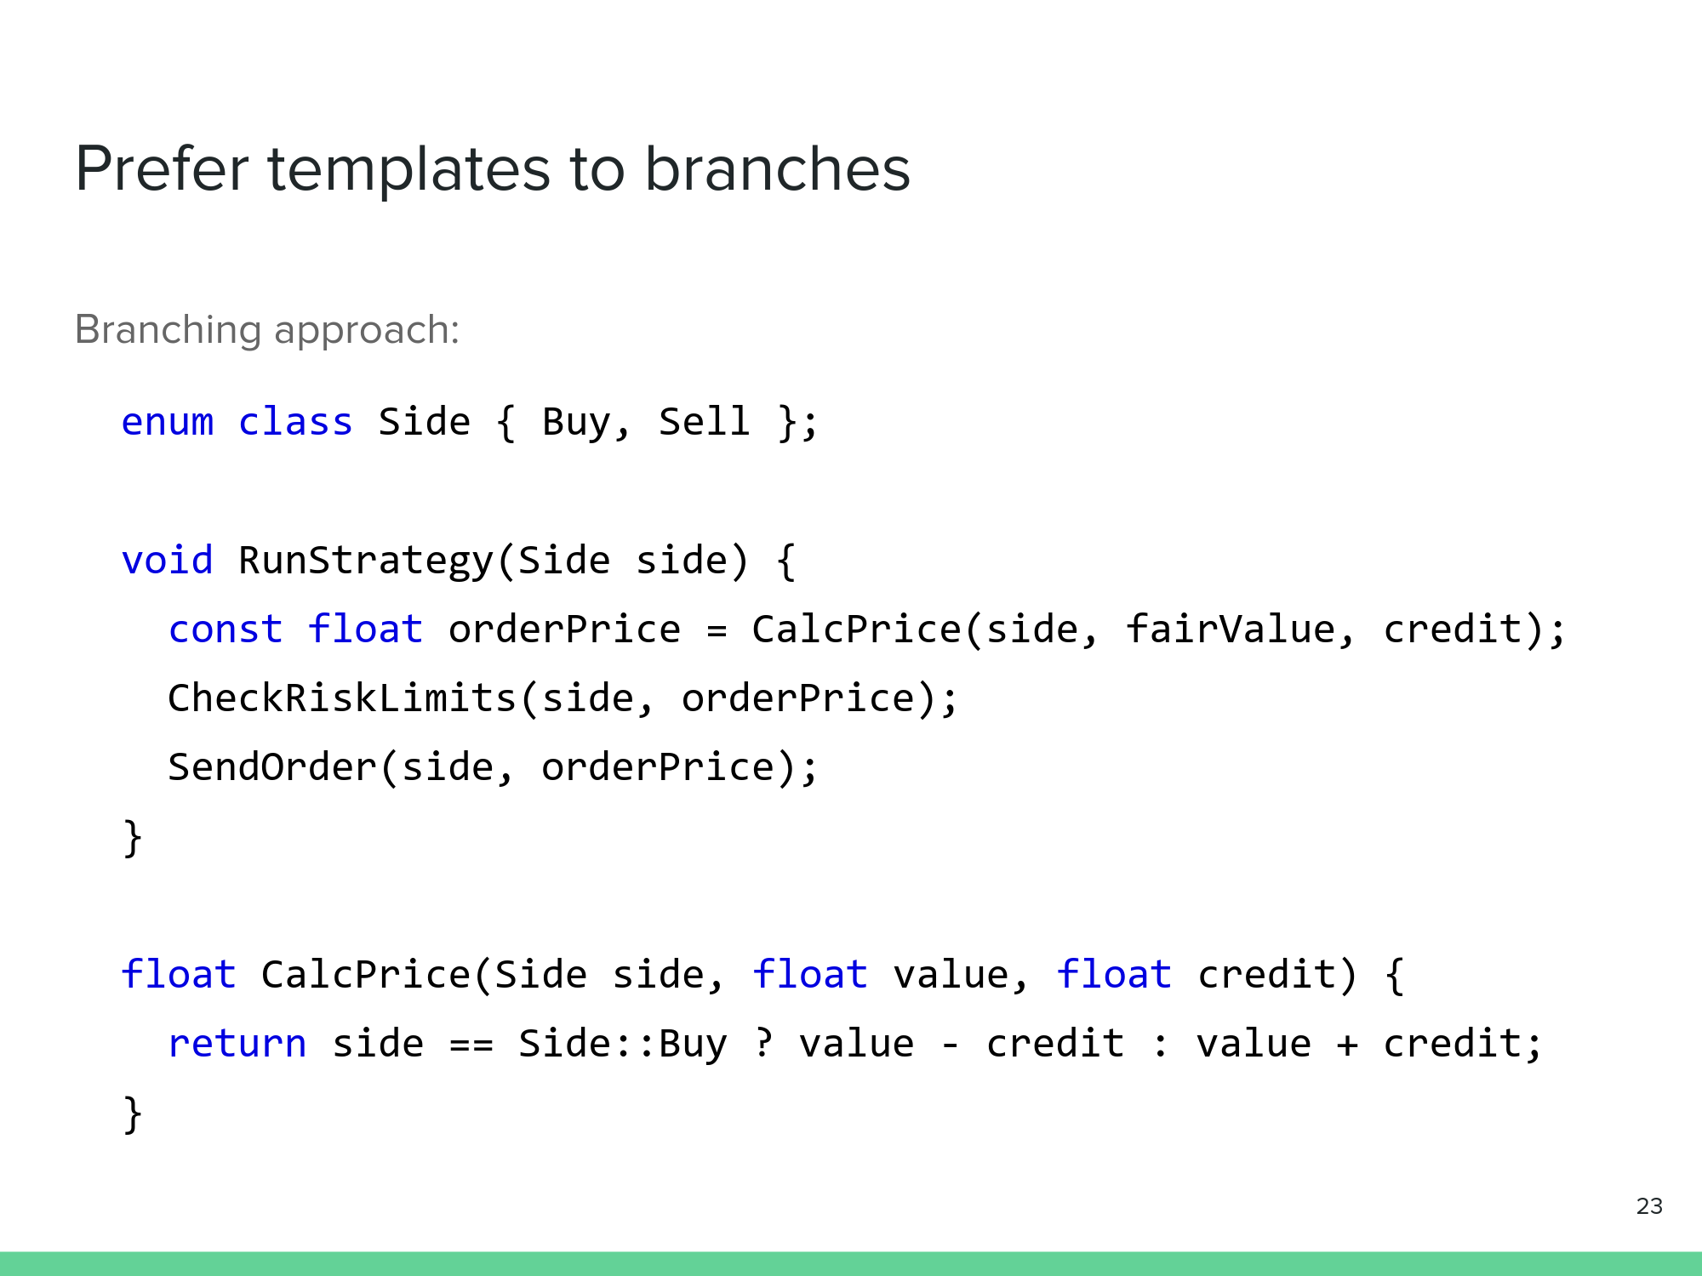
Using templates to eliminate branching
Notes:
Tom
https://www.davidhbailey.com/dhbpapers/overfit-tools-at.pdf

Slide 18
Allocating Memory
Allocations are costly – this cost can be alleviated by using a pool of preallocated objects
Deallocations are also costly: the free function in C++ numbers over 400 lines of code
Reusing objects reduces memory fragmentation
Notes:
Ethan

Slide 19
Multithreading
Multithreading seems like an easy performance win: just have 2 threads of execution at once, everything happens in half the time, right?
Multithreading forces you to use additional constructs to make sure that data stays synchronized. Using mutex locks can get expensive, not using programmatic locks doesn’t guarantee that the hardware isn’t locking under the hood
locks cost time, makes one thread wait while the other updates shared data
If multithreading is required, best practice is to minimize shared data, since multiple threads writing to one cache is expensive.
Passing copies of data between threads is less expensive. This is assuming that data must be synchronized – maybe it doesn’t have to be
Notes:
Ray

Slide 20
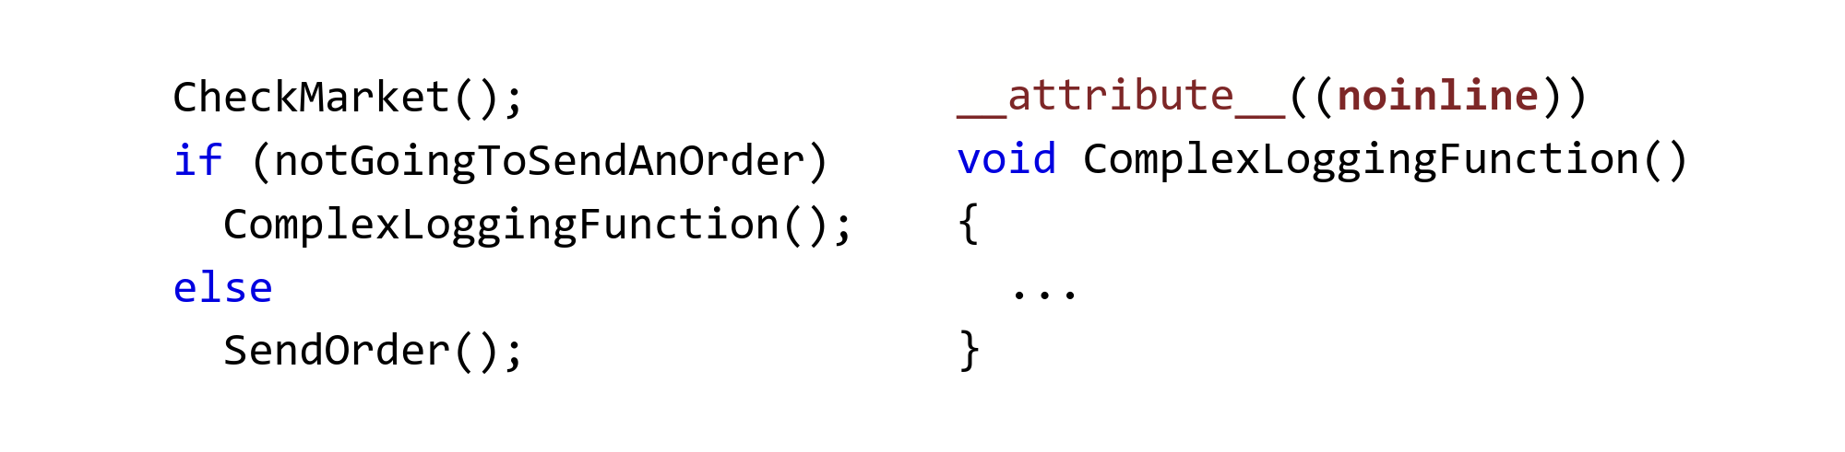
Inlining:
Inlining is the process of replacing a function call with the body of the function.
Inlining could make your code faster. It could also make your code slower
Similarly, not inlining could make your code faster or slower. It depends on many variables and the state of your machine when the inlined or non-inlined code is running
during a normal function call, you have to push arguments onto the stack/register, jump to the function, and then return the jump, which can all add up
You can control if a function is inlined using
__attribute__((noinline)) for no inlining
__attribute__((always_inline)) for inlining
Checking the market, if everything’s alright send an order, otherwise do some logging. Why would we force the compiler to not inline the logging?
Notes:
Ray
https://www.reddit.com/user/modern_football/

Slide 21
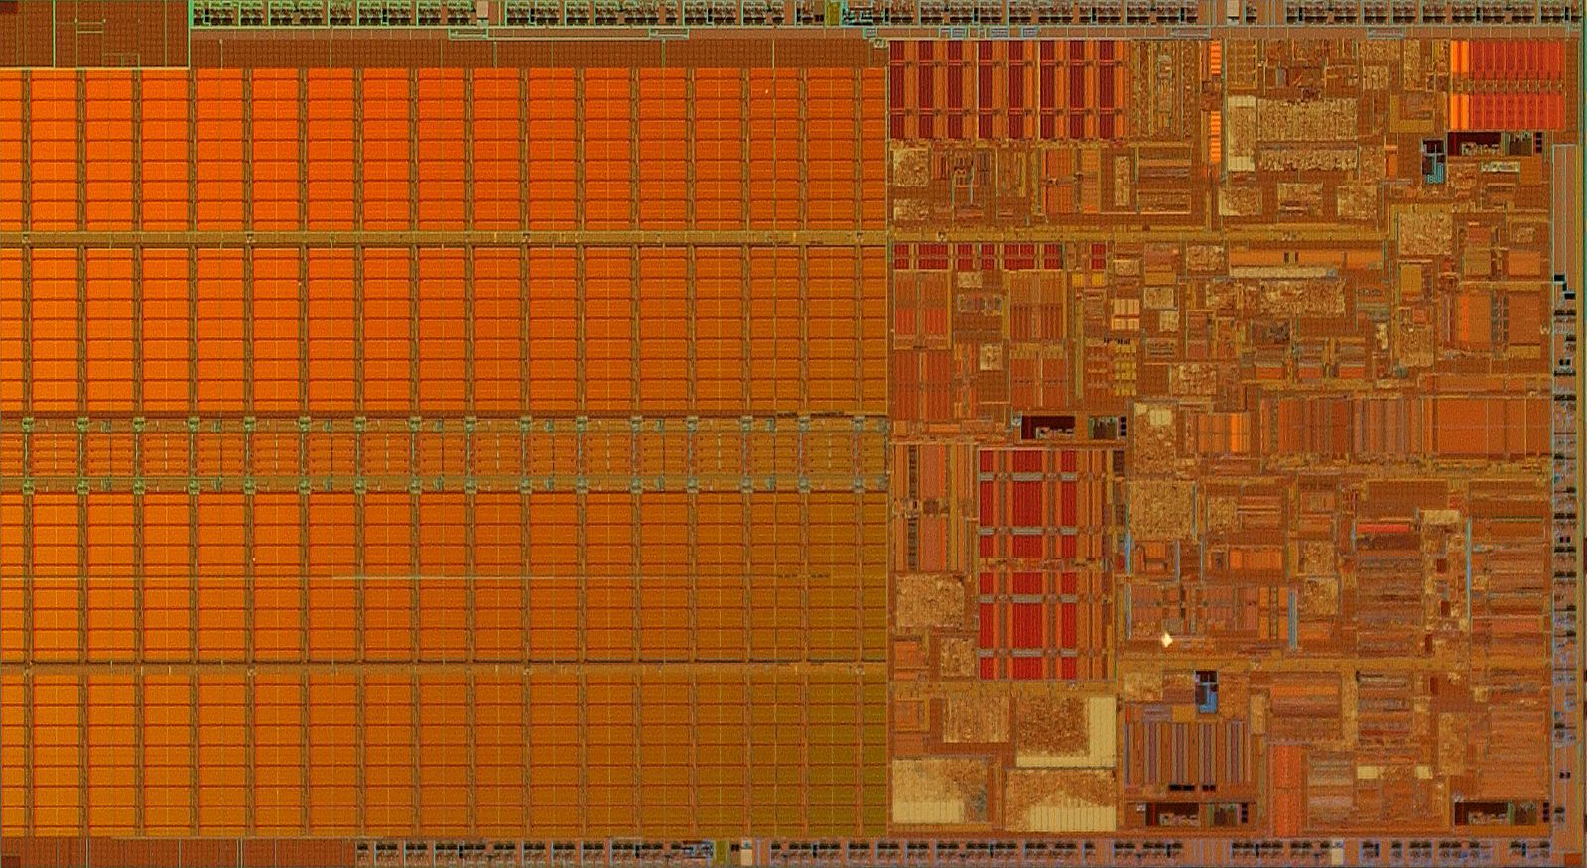
Computer Hardware
“I have always wished for my computer to be as easy to use as my telephone; my wish has come true because I can no longer figure out how to use my telephone.”
Bjarne Stroustrup
Notes:
Ray

Slide 22
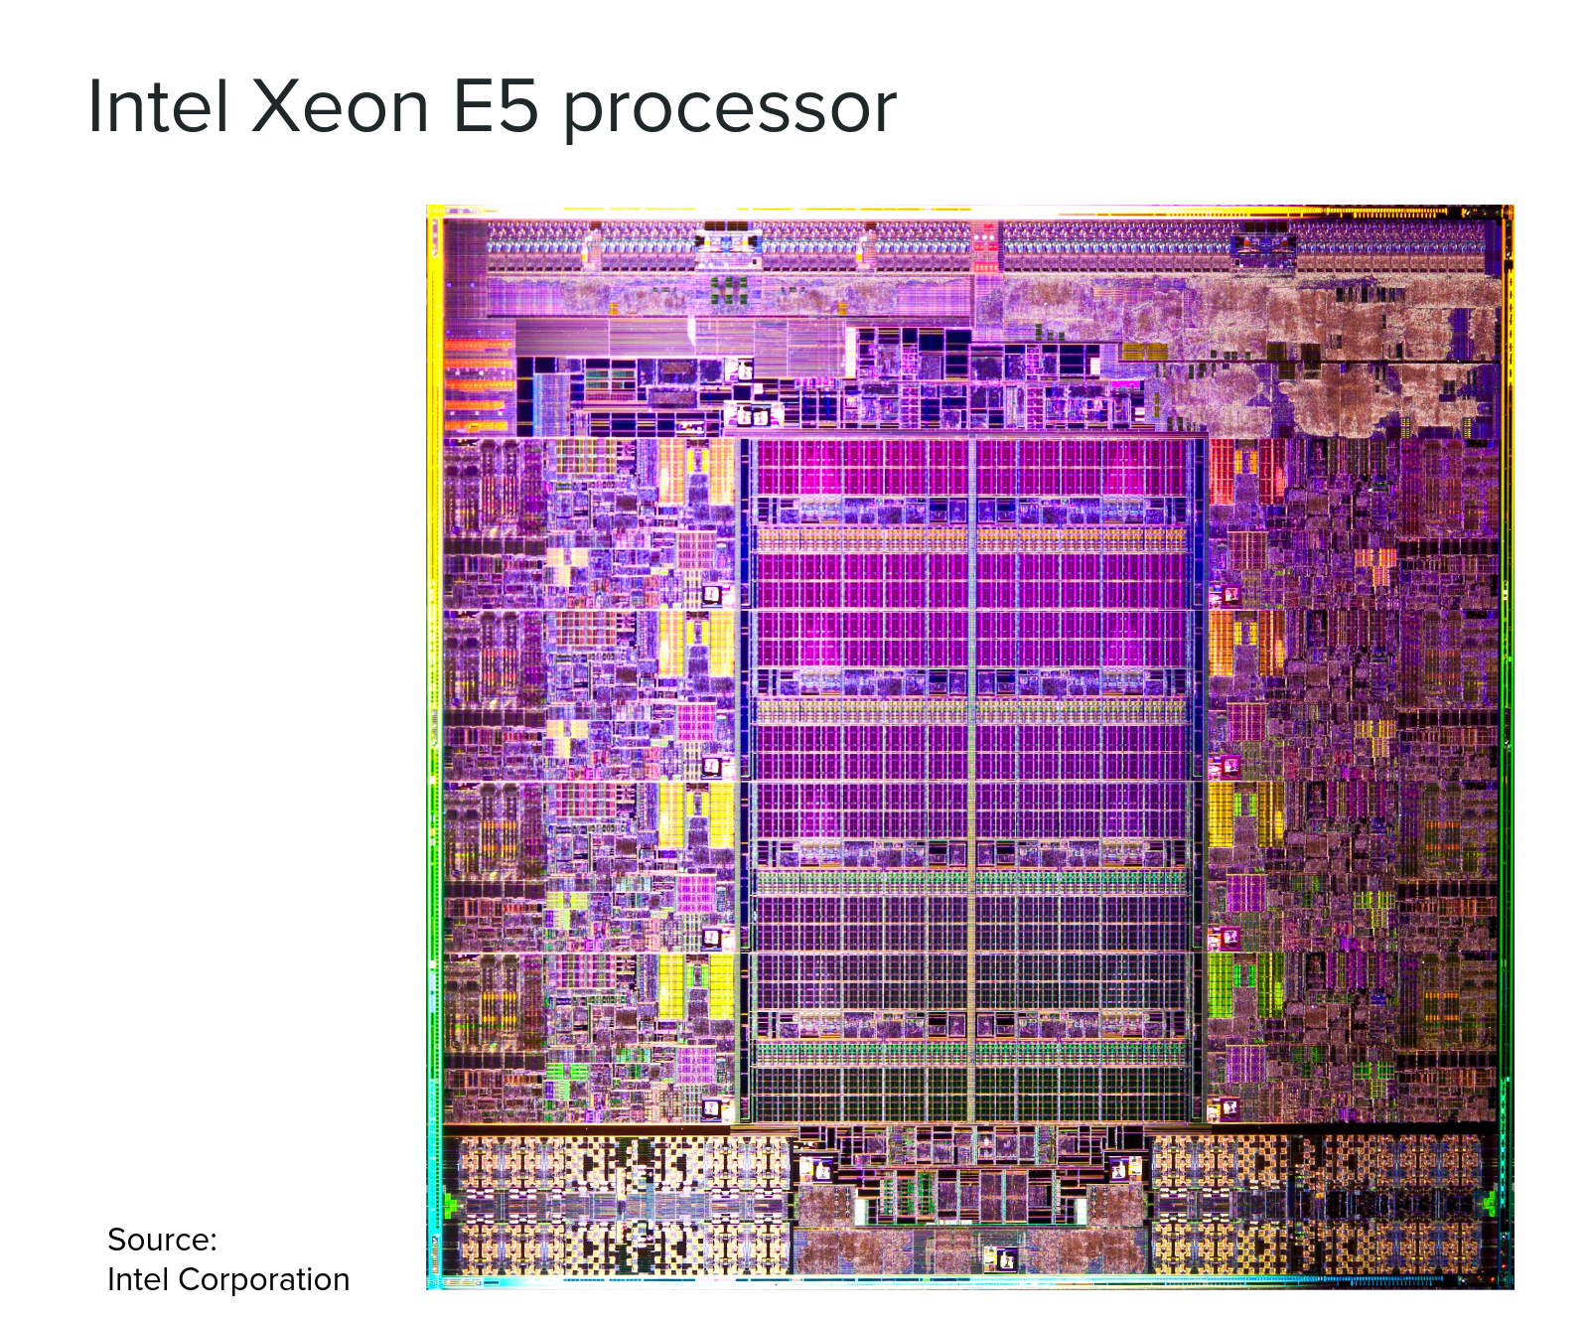
A Xeon E5 CPU. Pretty!
8 cores, 1 L3 cache ~15 MB. They all have to share the cache. We want our trading software to have all the cache to itself!
Either turn off the other cores or lock the cache. If you’re locking the cache, move any “noisy” neighbors to another physical CPU

Slide 23
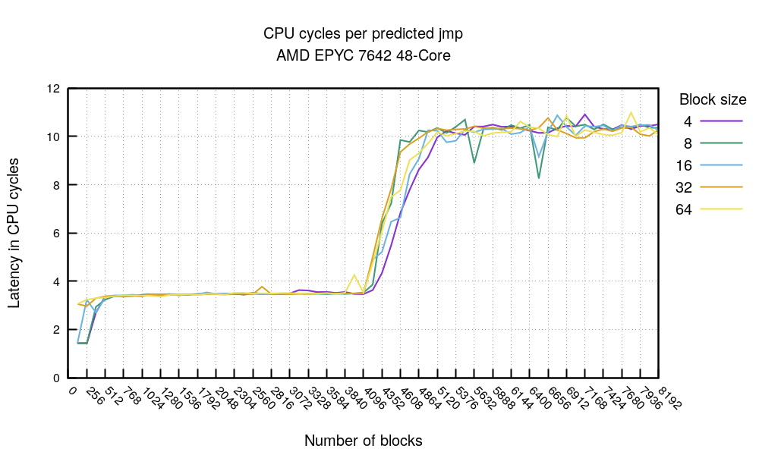
Why do we want to minimize branches?
Modern CPUs have branch predictors – this means that a digital circuit tries to guess which way a branch will go (if the condition is true or false) before the condition is evaluated definitively
The chart at the right is
data from an experiment
by Cloudflare. It shows
that if the amount of
code is small enough –
< 2048 bytes, it’s possible to
hit uop/L1 cache & get ~1.5
cycles per fully predicted
branch. For hot loops < 4096
branches, latency sticks to
~3.4 cycles. Above 4096
branches, the predictor
gives up and latency spikes.
Notes:
https://github.com/cloudflare/cloudflare-blog/tree/master/2021-05-branch-prediction
https://www.davidhbailey.com/dhbpapers/overfit-tools-at.pdf

Slide 24
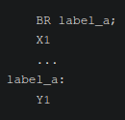
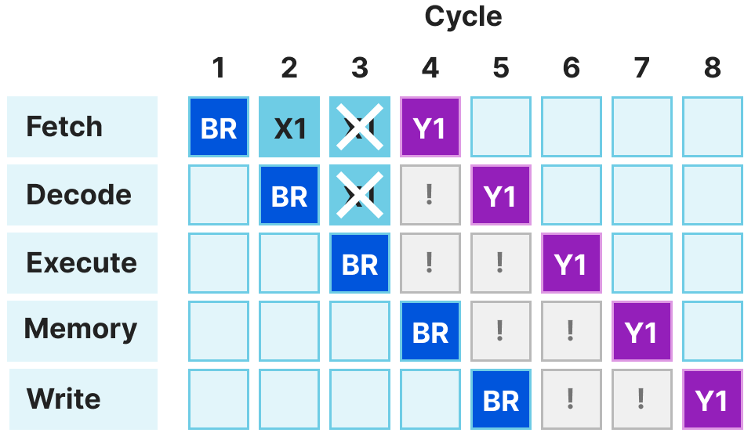
Why do we need branch prediction? Consider the ARM program at right
The execution of an instruction happens in 5 stages. First, the CPU fetches an instruction from memory. Second, the CPU’s control unit interprets the fetched, encoded instruction. It’s responsible for signalling needed components (ALU, FPU, etc) to prepare for execution. Third, the relevant units of the CPU execute the instruction. Then, data from the execution is read from or written to memory.
For this example, if no branch prediction is used, the first branch instruction is fetched in the first cycle. While the branch is being decoded, the CPU wants to fetch the next instruction (X1). But that instruction shouldn’t be run! So 2 cycles will be wasted on an instruction that shouldn’t be run.
Notes:
Ethan

Slide 25
Miscellaneous Optimizations
“Remember that there is no code faster than no code.”
Taligent's Guide to Designing Programs
Notes:
Ray

Slide 26
Choice of compiler matters!
Consider this example snippet: #include <functional>
struct Point {
double dimensions[3];
};
int main(int argc, char** argv){
//int powers10[5] = {1, 10, 100, 1000, 10000};
std::function<void()> no_op {[point = Point()] {}};
return 0;
}
GCC and Clang will compile this dramatically differently…
A compiler is a program that translate high level languages (Python, C++, etc.) into machine code (binary) that a computer’s processor can execute directly
Notes:
Ray

Slide 27
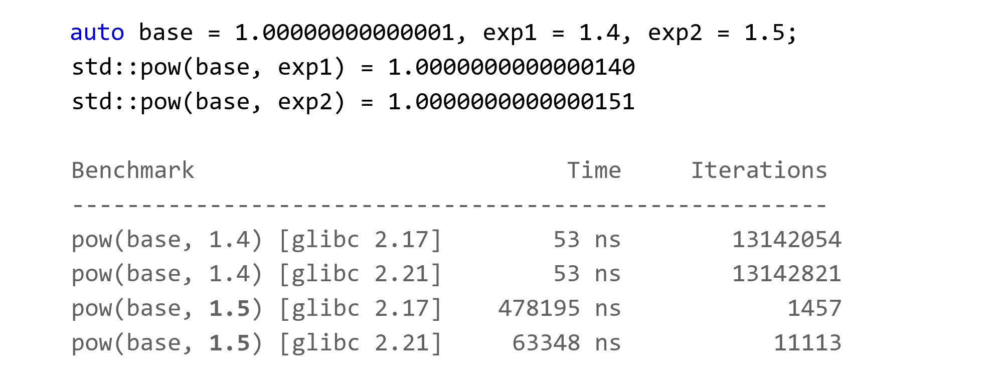
Exponentiation
Exponentiation can be slow, since glibc’s std::pow is a transcendental function (meaning it will try to get a correct answer quickly first, then it will try to get a correct answer slowly if that fails).
Notes:
Ray

Slide 28
Performance Testing
“Program testing can be used to show the presence of bugs, but never to show their absence!”
Edsger Djikstra
Notes:
Ray

Slide 29
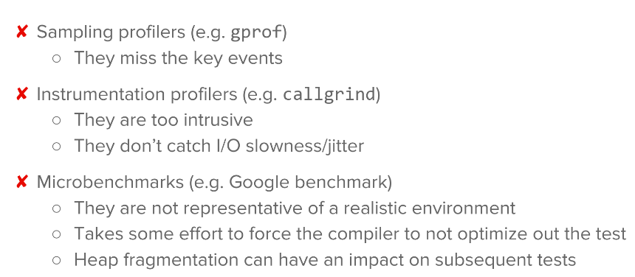
Measuring performance
Two main ways:
Profiling: examining what code is doing
Benchmarking: timing the speed of a system
They are not the same. Profiling is used to catch unexpected actions taken by code, and improvements in results on that front do not automatically imply that code is running faster
Notes:
Ray

Slide 30
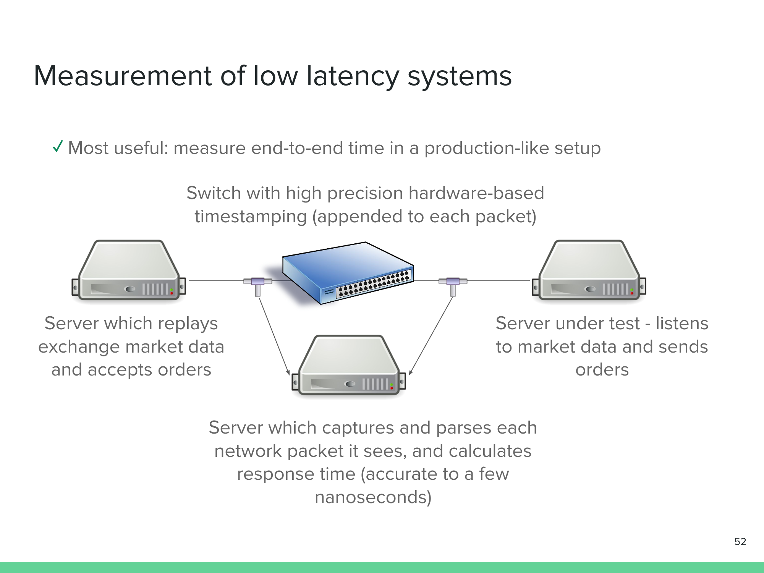
The method of perf testing used at most HFT firms.
Notes:
Ray

Slide 31
Conclusion:
Knowledge of C++ is critical, but it goes deeper than that. You also need to know your compiler, operating system, and hardware like the back of your hand
Do everything you can to simplify runtime logic (minimize branches, help your cache help you, approximate wherever possible instead of pursuing perfect accuracy)
At HFT scale, you can’t run testing/benchmarking tools on the same device as the execution of test code, since the tools will interfere with the code
Notes:
Ray
https://www.reddit.com/user/modern_football/

Slide 32
The Development Vertical
Quant developers, in general, develop software tools to facilitate research and trading. Examples include low-latency trading systems and data visualization software.
The Development vertical at CWRU Quants will work on a comprehensive backtesting framework that the Research and Trading verticals will use to backtest their strategies.
We currently have a working product! You can install it on your machine right now! pip install -i https://test.pypi.org/simple/ cwrubacktest
It currently has:
improved and more modular rebalancing logic
more customization over fee model in the simulation
more realistic trade execution logic
over the main open-source backtesting frameworks!
We need developers to work on:
better performance statistics and plotting
support for more strategies and signals
a test suite
and more
Notes:
Ray

Slide 33
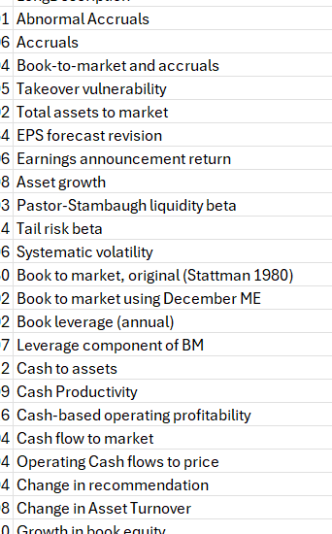
The Trading Vertical
Have large number (212 ) of already-established predictive signals
We also have the monthly returns, volume, shares outstanding, etc. of many stocks
Together, we will investigate what signals are the most effective (and in which industries too)
Currently working on methodology and framework
Later, just plug-in different inputs and see what works best
Notes:
Christo

Slide 34
The Research Vertical
We are currently doing sentiment and semantic analysis on earnings transcripts, and hope to mine a large feature set to eventually train various ML algorithms on this fall semester
We work mainly in python, and do a lot of paper reading to understand where the level of academia is at, and what we can do to continue building out our features
Timeline
Spring25: Build out feature set
Summer25: Build out feature set + add labels
Fall25: Algorithm development
Notes:
Ethan
I think you guys should also look to develop some proprietary signals (to compare how good the ones we make are against the ones in the paper)
This can be a large portion if you need to be^
For example, scrape the linkedin posts of company management to get some signal
Or…get some sources of alternative data (like company management private jet logs) and see if there is any relation to company disclosures, stock price, etc.

Slide 35
The Education Vertical
Continue working on our volatility project, which we will deliver in a few weeks
Notes:
Ethan
I think you guys should also look to develop some proprietary signals (to compare how good the ones we make are against the ones in the paper)
This can be a large portion if you need to be^
For example, scrape the linkedin posts of company management to get some signal
Or…get some sources of alternative data (like company management private jet logs) and see if there is any relation to company disclosures, stock price, etc.

Slide 36
QUESTIONS AND ANSWERS
Contact us!
Email: quants@case.edu
Instagram: @cwruquants

